Slide 1



Data Science vs. Data Analytics
Anish Mahapatra | 4th May, 2023

Slide 2

Agenda
01
Introduction
02
What is Data Science?
03
What is Data Analytics?
04
Why to choose Data Science or Data Analytics?
05
Tools & Technologies, Job Strategies and CTC
06
Let’s Talk!

Slide 3











Topic 1 of 6
Introduction: Am I worth your time?
Mentored over 2000+ people in Data Science
Senior Data Scientist at a Fortune 200 company
Writer, Teacher, Webinar Expert in Data Science
Consultant to 7+ Fortune 500 companies
Subject Matter Expert in multiple Data Science Topics including Chatbots, Kafka, ML & AI
PGD from IIIT Bangalore + MSc in Data Science
6 years of experience in Data Science
Senior Data Scientist
LinkedIn: www.linkedin.com/in/anishmahapatra Medium: anishmahapatra.medium.com Website: www.anishmahapatra.com
GitHub: www.github.com/anishmahapatra
Q. How to get into Data Science?
A. Simple, ask a real-world Data Scientist.

Slide 4



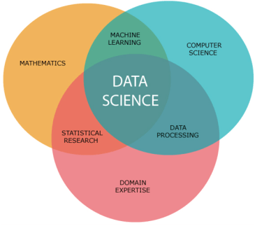
Topic 2 of 6
What is Data Science?
01
02
03
Mathematics
Business
Technology
Understanding the fundamentals of Data Science requires mathematics
Business is the core of every Data Science problem
Evolving technology is what keeps Data Science ahead of every other industry
Notes:
In Industry 3.0, we automate processes using logic processors and information technology. These processes often operate largely without human interference, but there is still a human aspect behind it. Where Industry 4.0 comes in is with the availability and use of vast quantities of data on the production floor.

Slide 5
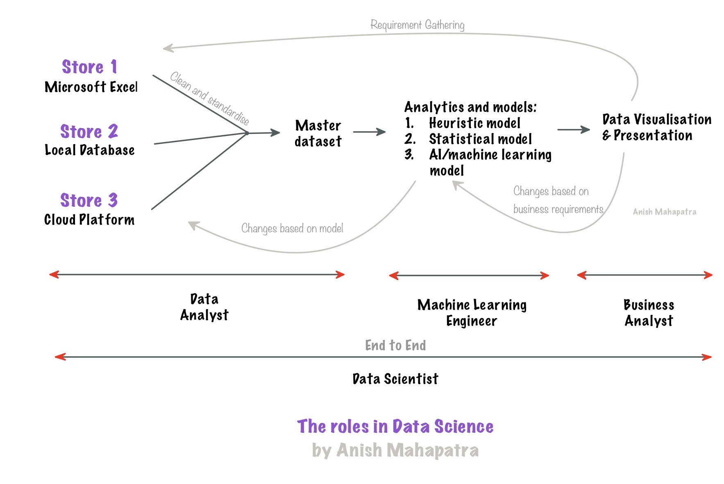
Topic 2 of 6
What is Data Science?
Notes:
APOLLO Hospital Pharmacy Example

Slide 6
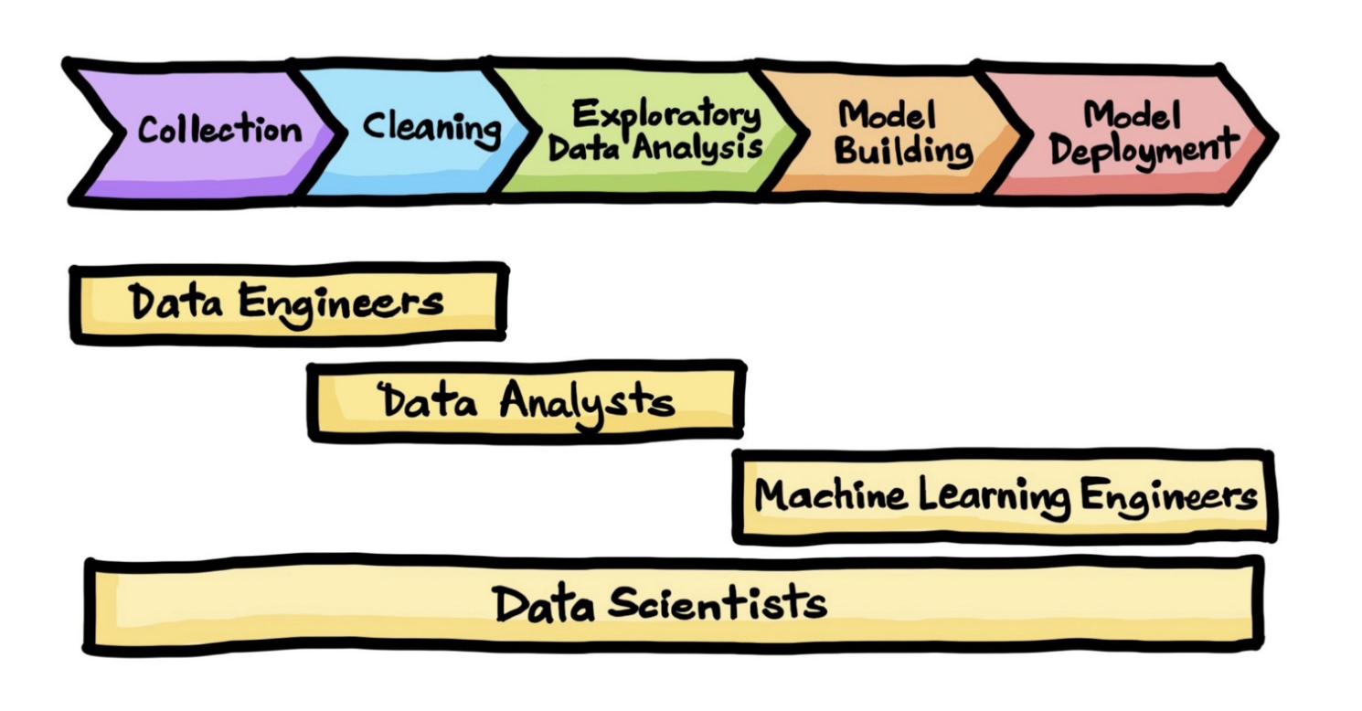

Topic 2 of 6
What is Data Science?
Notes:
APOLLO Hospital Pharmacy Example

Slide 7




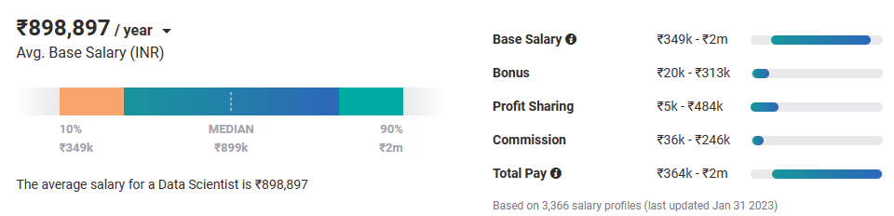
Topic 2 of 6
Why choose Data Science?
01
02
03
Relevance in the future
Business & Technology
Industry-Agnostic
Companies are building and growing in Data and it is the future.
Data Science is a combination of Business, Math and Technology, so growth can be in business / technology
Use your existing knowledge / domain / technology expertise with a data-edge
04
Extremely High Market Demand
Supply-Demand mismatch means companies are willing to pay more
Notes:
Source:https://www.payscale.com/research/IN/Job=Data_Scientist/Salary

Slide 8






Topic 3 of 6
What is Data Analytics?
Understand the patterns &
structure of data
Deal with the tracking of data
and understand databases
Data Analysts need to understand how the data is stored and structured
Tracking and maintaining large pipelines is an integral part of the Data Analyst’s job
Build pipelines to
enable the flow of data
Track the quality and
governance of data
Data pipelines are an
integral part of data lifecycle
It is important that the right people
have access to the right set of data
Own the Data
In any organization, Data Analyst’s own parts of the data flow, and can add a lot of value

Slide 9

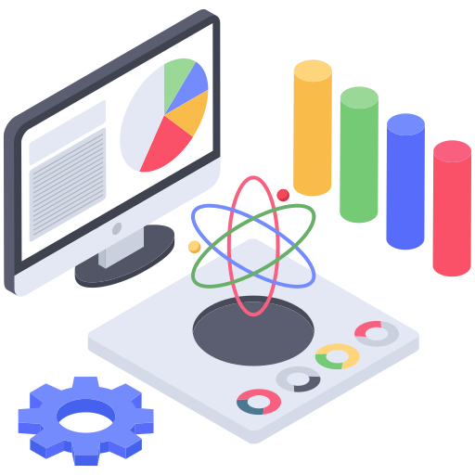



Topic 4 of 6
Why choose Data Science or Data Analytics?
Area of Interest in the Data Field
It is critical to understand yourself and your areas of interest to understand where you belong
Domain Expertise
Based on your previous experience, you can decide which area you would like to go into
Market Supply-Demand
Always follow the market. Understanding the supply and demand curves of the market will help you get the best paying job
Tools & Technologies
Having the right tools and skillset
can help you navigate the right jobs

Slide 10

Topic 4 of 6
How to leverage a degree to get there?
01
02
03
Set Target
Talk to people
Build LinkedIn Profile
Understand the Data Field,
Understand roles & responsibilities,
Look at a 5-year path
Talk to people who are already doing what you want to do
Add certifications, participate in competitions, do simple projects, look at how the best of the best do it
06
05
04
Build Collaterals & Profile (30%)
Globally Accepted Degree (70%)
Explore Certifications
Multiple certifications don’t help, the quality of it does.
GitHub, LinkedIn,
Medium, Brand Profiling
Globally recognized degree, Degree Accepted by MNCs,
Possibility of PhD later,
Alumni Status
Bonus - WES Certification, Teachers from the industry
Notes:
All we care about is how to get a job, let me tell you how to leverage MSc to get a job!

Slide 11





Topic 3 of 6
Components of an Online Degree
Q. What do you really want from a Degree?
01
02
All Companies should
recognize my degree
My Degree should be
Recognized globally
Companies like Amazon, Microsoft, Fortune 500:
all recognize this as a full-fledged
Post graduate and Master’s Degree
India or Abroad, everyone should recognize my degree. This is possible because of the WES Certification
04
03
I should be able to get a transition my job or get a jump in my salary
Possibility of
Higher Studies
On Average, having a relevant MSc Degree will get you 40% more in the market
If you wish, you should be able to pursue even higher degrees later
Notes:
Source:https://www.payscale.com/research/IN/Job=Data_Scientist/Salary

Slide 12
Topic 3 of 6
The Main Question
So, was it worth it to get a degree in Data Science?
Did it help in the real-world?
Notes:
Source:https://www.payscale.com/research/IN/Job=Data_Scientist/Salary

Slide 13













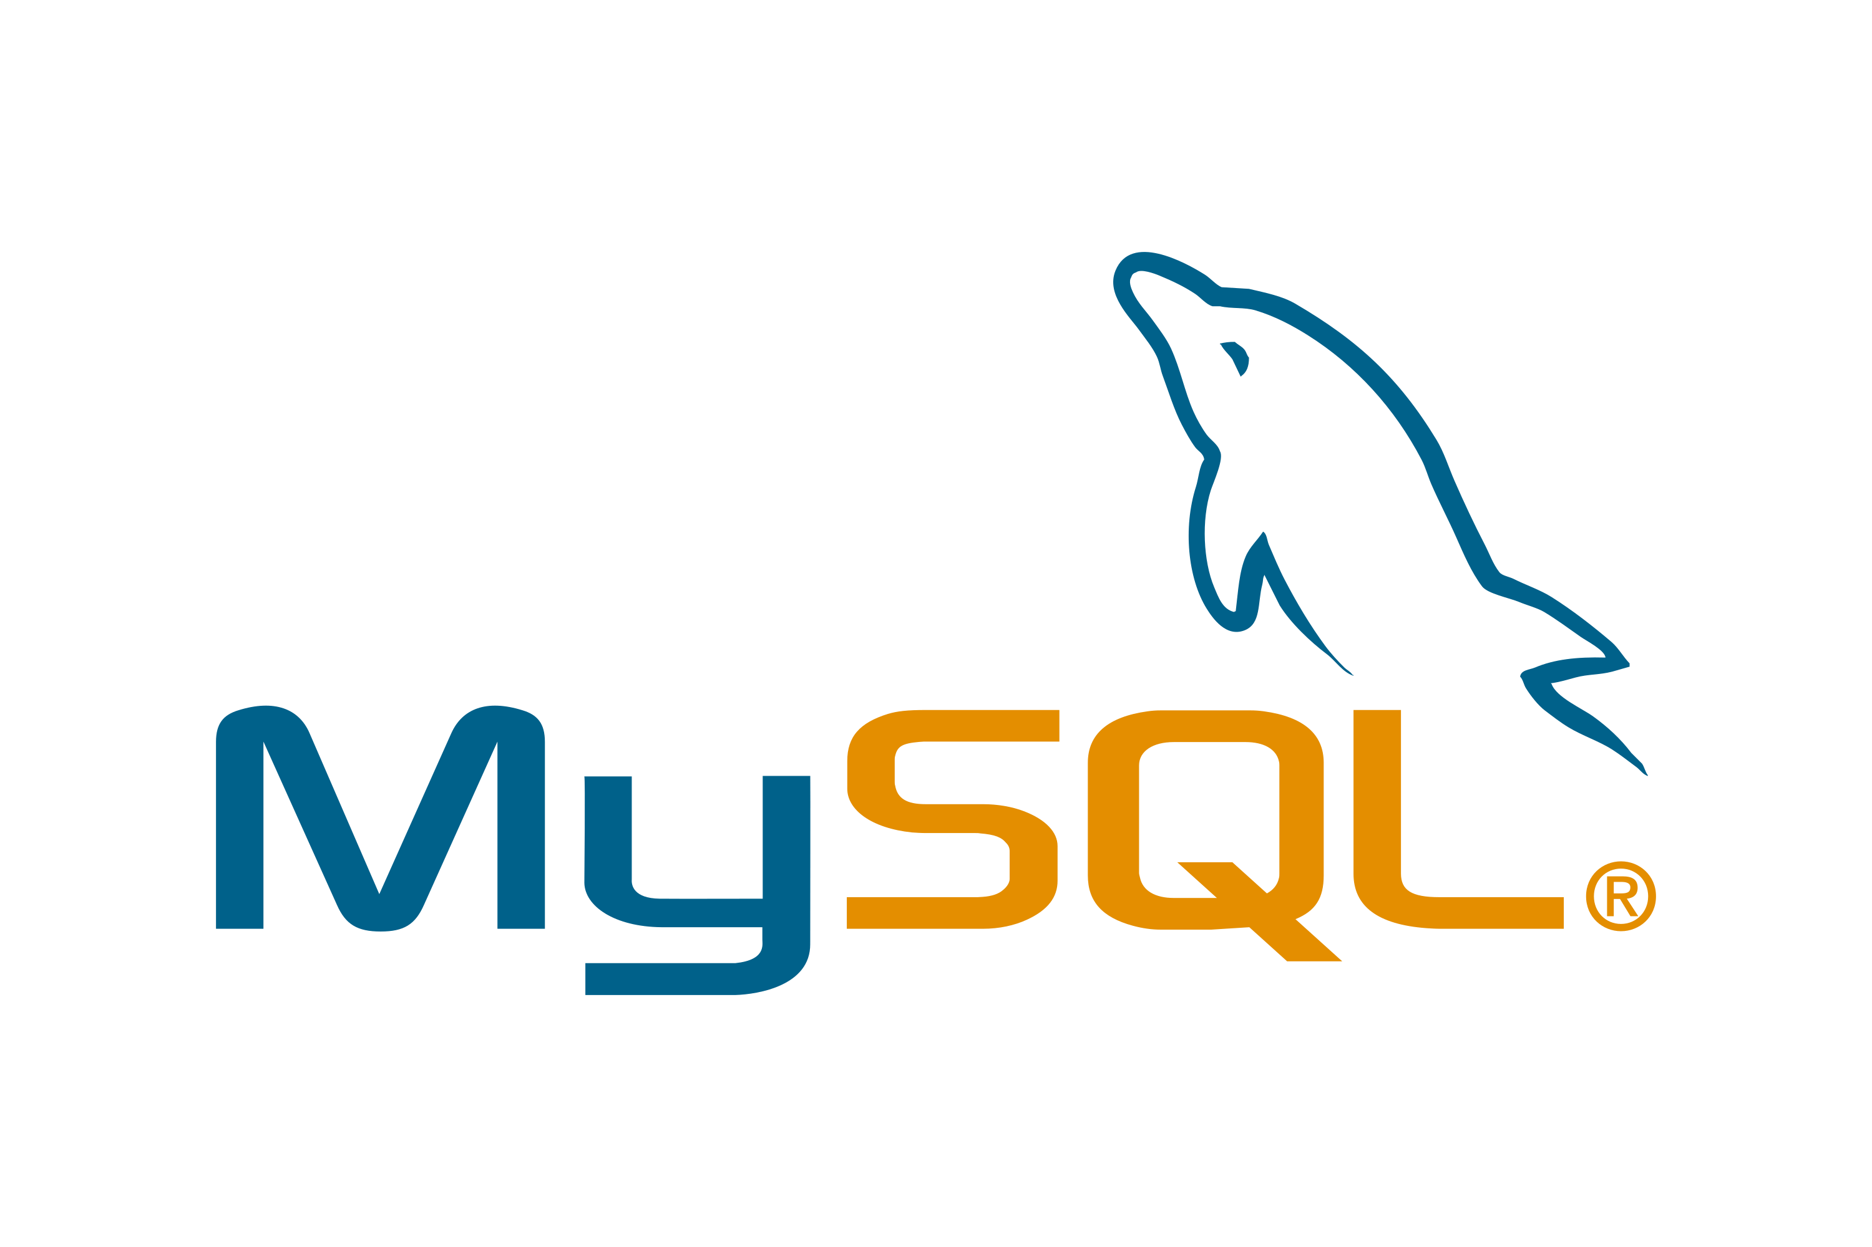

Topic 5 of 6
Tools & Technologies in Data Science
Data Analyst
Machine Learning Engineer
Business Analyst
Data Scientist

Slide 14
Topic 4 of 6
FAQs
1. Will UpGrad give me a job?
2. What if UpGrad stops responding after I register?
3. What is the difference from doing a course offline or abroad?
4. When should I do the course?

Slide 15





Topic 5 of 6
Resume Optimization

Slide 16
Key Takeaways
01
Introduction
02
What is Data Science?
03
What is Data Analytics?
04
Why to choose Data Science or Data Analytics?
05
Tools & Technologies, Job Strategies and CTC
06
Let’s Talk!

Slide 17

Data Science vs. Data Analytics
Anish Mahapatra
Let’s Talk!
LinkedIn: www.linkedin.com/in/anishmahapatra
Email: anishmahapatra01@gmail.com

